Slide 1
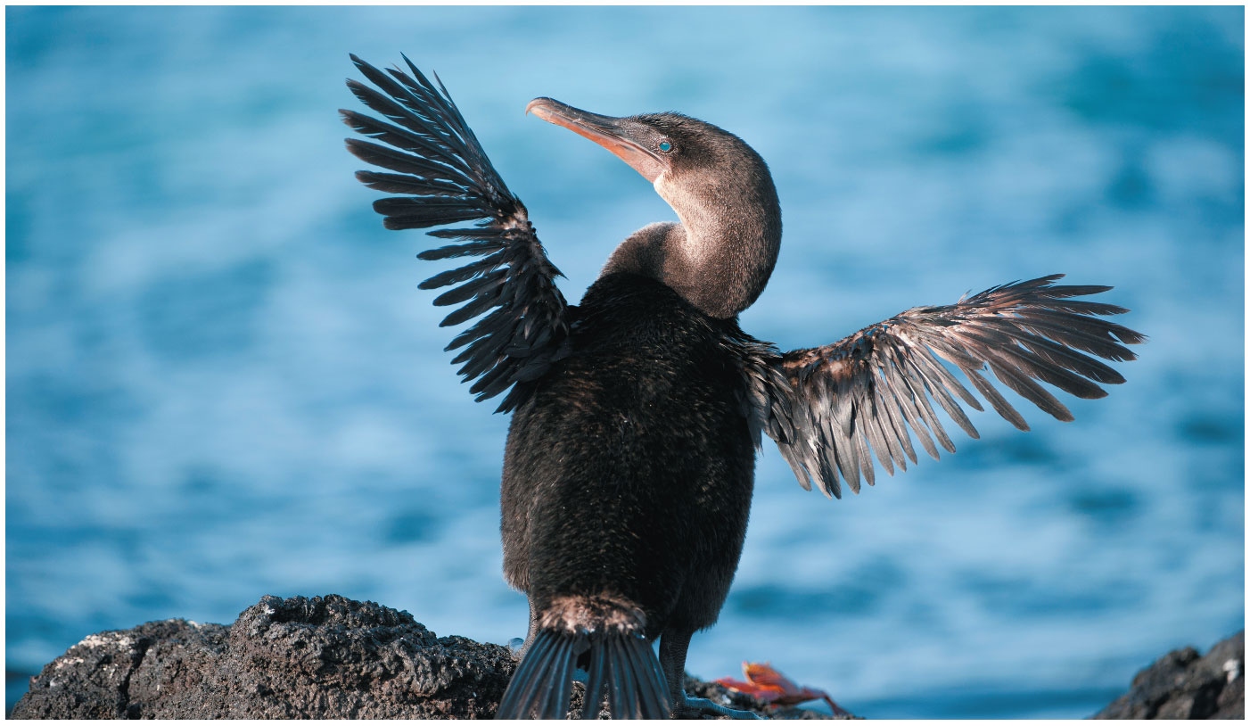
CH 24 lecture
LSU BIOL 1202
General Biology II Lecture
CHAPTER 24
The Origin of Species
Dr. Adam Hrincevich
Notes:
Figure 24.1 How did this flightless bird come to live on the isolated Galápagos Islands?

Slide 2
CH 24 Learning Objectives
Define the biological species concept, and identify reproductive barriers that could isolate a species' gene pool from that of other species.
Compare and contrast allopatric speciation and sympatric speciation.
Explain what a hybrid zone is, and identify possible outcomes for a hybrid zone over time.
Give examples that show how speciation can occur rapidly or slowly, and can result from changes in few or many genes.
I would suggest completing the crossword puzzle to help you understand the terminology and correlate how the terms relate to topics covered in this chapter.

Slide 3
Concept 24.1: The biological species concept emphasizes reproductive isolation
Species is a Latin word meaning
Biologists compare morphology, physiology, biochemistry, and
The biological species concept states that a species is a group of populations whose members have the potential to interbreed in nature and produce viable, fertile offspring; they do not
Gene flow between populations holds

Slide 4
Reproductive Isolation
Reproductive isolation is the existence of biological factors (barriers) that impede two species from
Hybrids are the offspring that result from mating between
Reproductive isolation can be classified by whether factors
  Prezygotic
  Postzygotic

Slide 5
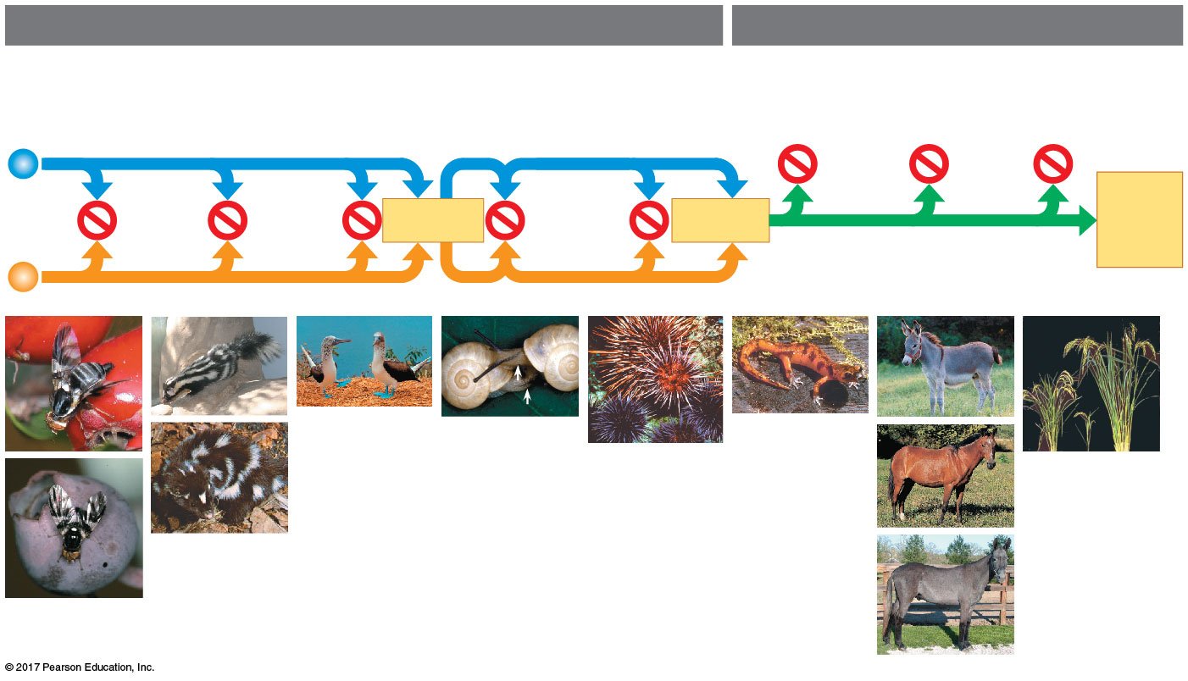
Figure 24.3
Prezygotic barriers
Postzygotic barriers
Habitat
isolation
Temporal
isolation
Behavioral
isolation
Mechanical
isolation
Gametic
isolation
Reduced
hybrid
viability
Reduced
hybrid
fertility
Hybrid
breakdown
Indivi-
duals of
different
species
VIABLE,
FERTILE
OFF-
SPRING
MATING
ATTEMPT
FERTILI-
ZATION
(a)
(c)
(e)
(f)
(g)
(h)
(i)
(l)
(d)
(j)
(b)
(k)
Notes:
Figure 24.3 Exploring reproductive barriers

Slide 6
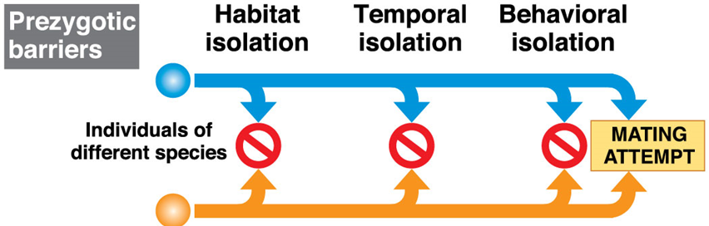
Slide 6
Prezygotic barriers block fertilization from
occurring by
  Impeding
  Preventing
  Hindering
Notes:
Figure 24.3a Exploring reproductive barriers (part 1: prezygotic barriers)

Slide 7
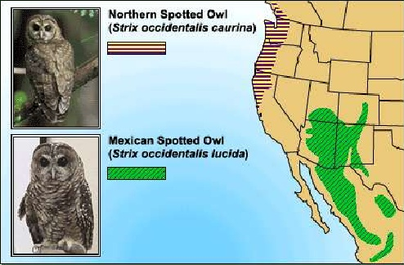
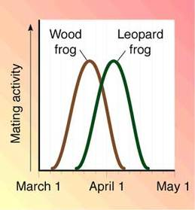
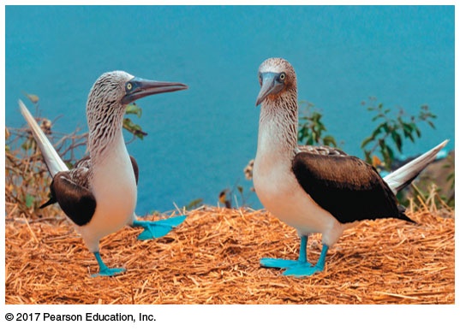
Slide 7
Habitat isolation: Two species encounter each other rarely, or not at all, because they occupy different habitats, even though
Temporal isolation: Species that breed at different times of the day, different seasons, or different years cannot
Behavioral isolation: Courtship rituals & other unique behaviors to a
(b)
Notes:
Figure 24.3aa Exploring reproductive barriers (part 1a: habitat isolation, hawthorns and apples)
Figure 24.3ab Exploring reproductive barriers (part 1b: habitat isolation, blueberries)

Slide 8
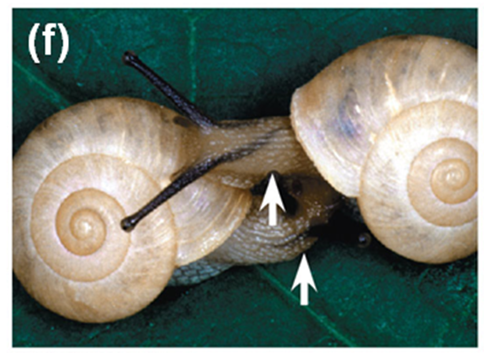
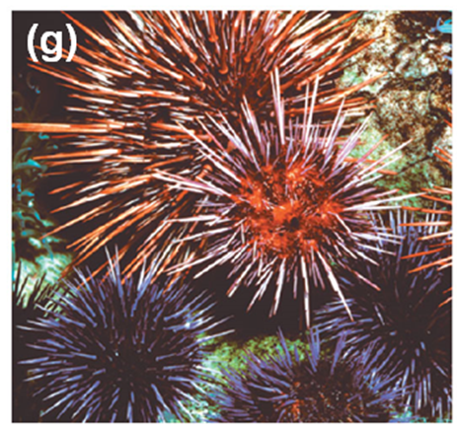
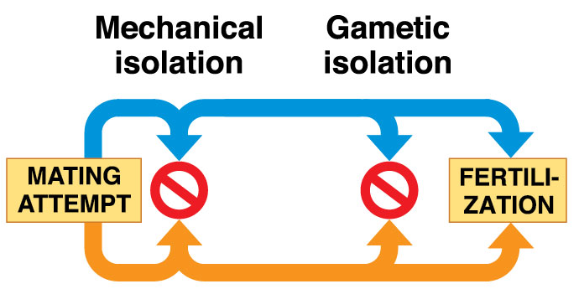
Slide 8
Mechanical isolation: Morphological differences can prevent
Gametic Isolation: Sperm of one species may not be able to
Notes:
Figure 24.3ba Exploring reproductive barriers (part 2a: mechanical isolation)

Slide 9
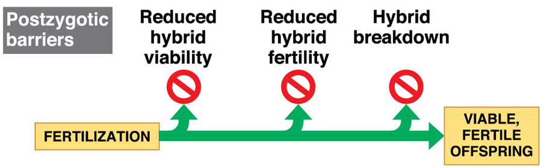
Slide 9
Postzygotic barriers prevent the hybrid zygote from developing into a
Notes:
Figure 24.3c Exploring reproductive barriers (part 3: postzygotic barriers)

Slide 10
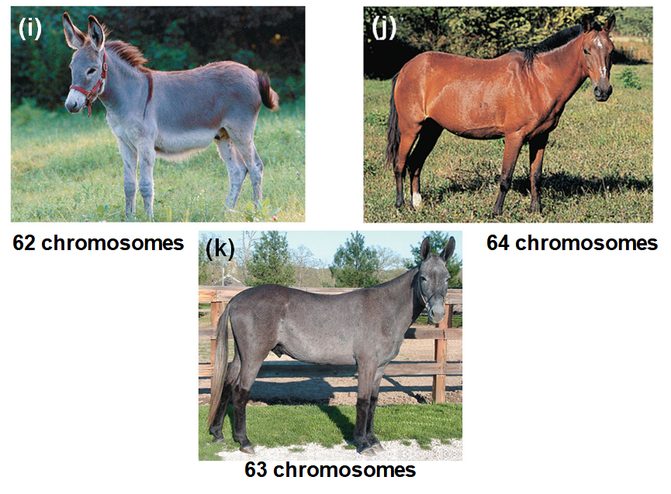
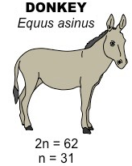
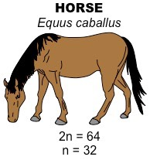
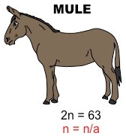
Slide 10
Reduced hybrid fertility: Even if hybrids are vigorous, they
“jack”
“mare”
♂
♀
X
“mule”
♀ donkey “jenny”
X
♂ horse “stallion”
↓
“hinny”
STERILE
Notes:
Figure 24.3cb Exploring reproductive barriers (part 3b: reduced hybrid fertility, donkey)
Figure 24.3cc Exploring reproductive barriers (part 3c: reduced hybrid fertility, horse)
Figure 24.3cd Exploring reproductive barriers (part 3d: reduced hybrid fertility, mule)

Slide 11
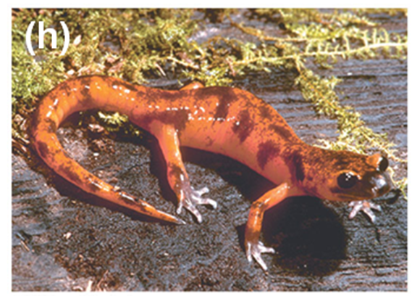
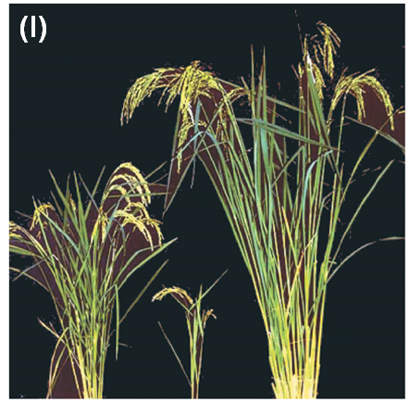
Slide 11
Reduced hybrid viability: Genes of the different parent species may interact and impair the hybrid’s development or
Hybrid breakdown: Some first-generation hybrids are fertile, but when they mate with each other or with either parent species, offspring of the next generation are
Notes:
Figure 24.3ca Exploring reproductive barriers (part 3a: reduced hybrid viability)

Slide 12
Limitations of the Biological Species Concept
The biological species concept cannot be applied to fossils or
The biological species concept emphasizes
However, gene flow can occur between
  EX: grizzly bears and

Slide 13
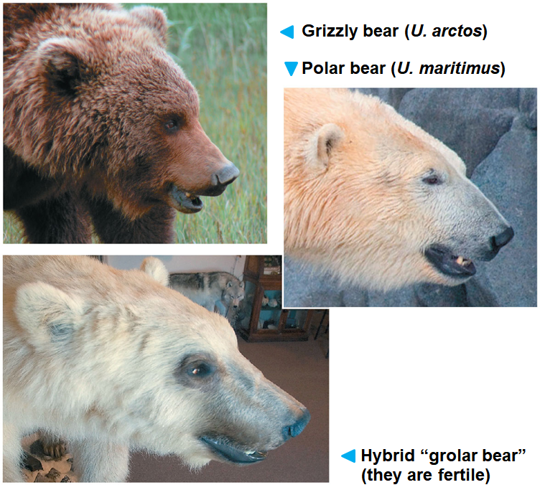
Figure 24.4
74 chromosomes (37 prs)
74 chromosomes (37 prs)
74 chromosomes (37 prs)
Notes:
Figure 24.4 Hybridization between two species of bears in the genus Ursus

Slide 14
Slide 14
Other species concepts emphasize the unity within a species rather than the
The morphological species concept defines a species by
  It applies to sexual and asexual species but
The ecological species concept defines a species in terms of
  It applies to sexual and asexual species and emphasizes
Many species definitions have been proposed; the usefulness of each depends on the

Slide 15
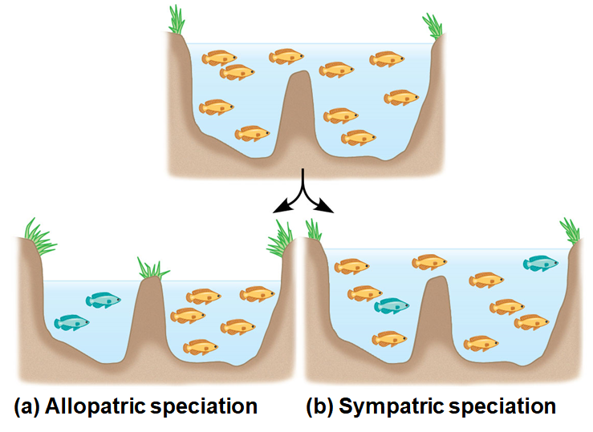
Concept 24.2: Speciation can take place with or without geographic separation
Speciation (1 species splits into 2+ species) can occur as a result of two general processes:
  Allopatric speciation
  Sympatric speciation
The difference between these two general processes is whether
Notes:
Figure 24.5 The geography of speciation

Slide 16
1. Allopatric (“Other Country”) Speciation
Allopatric speciation: gene flow is interrupted or reduced when a population is
  EX: the flightless cormorant of the Galápagos likely originated from
Peripatric speciation (a type of allopatric speciation)
  a new species is formed from
  resembles allopatric speciation since populations are isolated and
  it can be difficult to
Notes:
Figure 24.1 How did this flightless bird come to live on the isolated Galápagos Islands?

Slide 17
The Process of Allopatric Speciation
The definition of barrier depends on the
  EX: a canyon may create a barrier for
Separated populations may evolve independently through
Reproductive isolation may arise as a
  EX: isolated populations of mosquitofish have become reproductively isolated as a result of

Slide 18
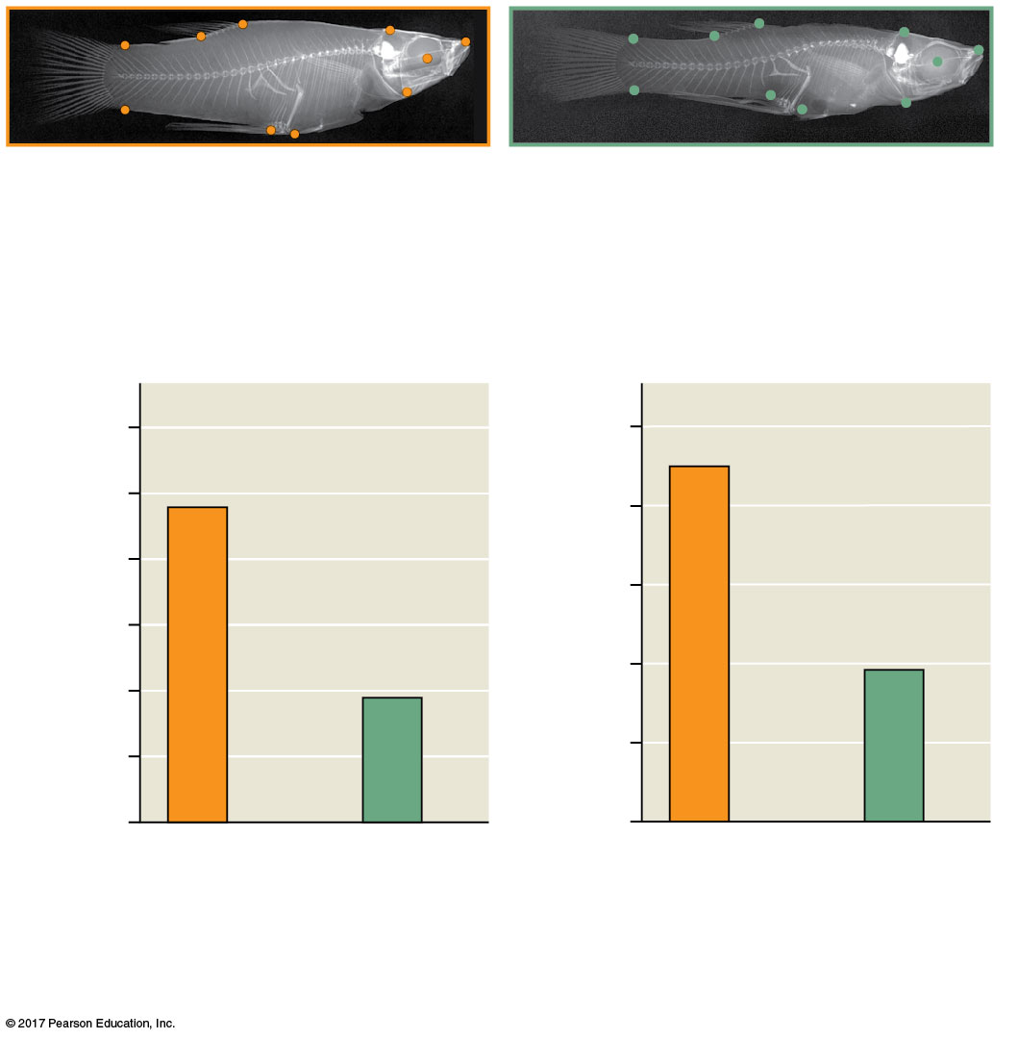
Figure 24.6
With predators: body
shape that enables rapid
bursts of speed
Without predators: body
shape that favors long,
steady swimming
(a) Differences in body shape
Escape acceleration (m per s²)
Survival rate with predators
110
1.0
100
0.8
90
0.6
80
0.4
70
60
0.2
50
0.0
Source pond:
predators
present
Source pond:
no
predators
Source pond:
predators
present
Source pond:
no
predators
(b) Differences in escape acceleration and survival
Notes:
Figure 24.6 Evolution in mosquitofish populations

Slide 19
2. Sympatric (“Same Country”) Speciation
Sympatric speciation: speciation occurs in populations that live
Parapatric speciation (type
  two species evolve in
  maintain a zone of contact and do not
Sympatric speciation can occur if gene flow is reduced by factors including

Slide 20
A. Polyploidy
Polyploidy is the presence of extra sets of chromosomes due to
Polyploidy is much more common in
Polyploidy can produce new
An autopolyploid is an individual with more than
The offspring resulting from

Slide 21
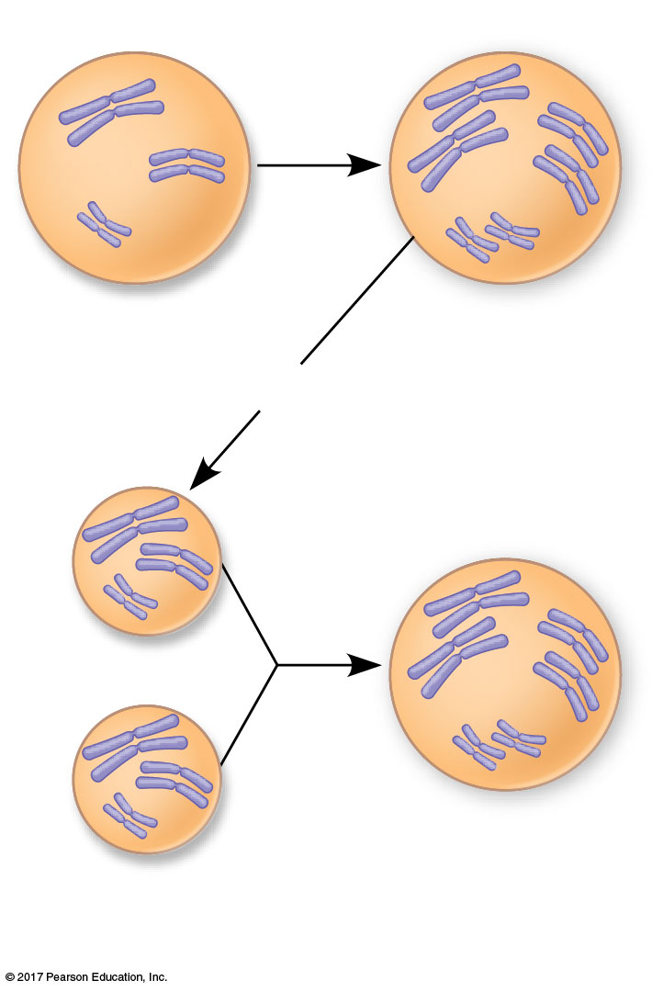
Figure 24.9
Cell
division
error
Diploid Cell
Tetraploid cell
4n
2n = 6
Meiosis
2n
2n
Cell from
new species
(4n)
Gametes produced
by tetraploids
Notes:
Figure 24.9 Sympatric speciation by autopolyploidy

Slide 22
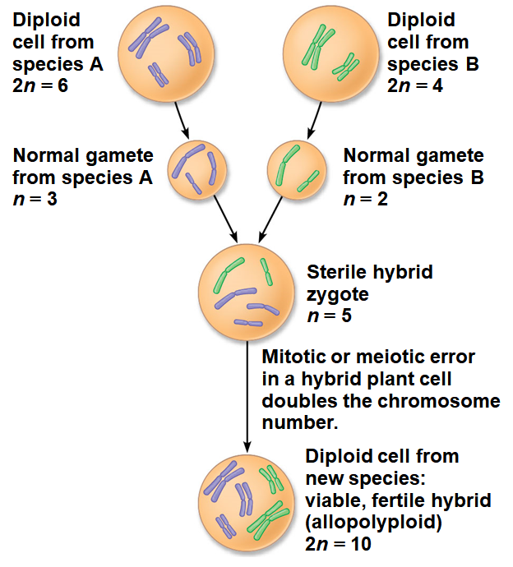
Slide 22
An allopolyploid is a species with multiple sets of chromosomes
Allopolyploids can successfully mate with each other, but cannot
Notes:
Figure 24.10_3 One mechanism for allopolyploid speciation in plants (step 3)

Slide 23
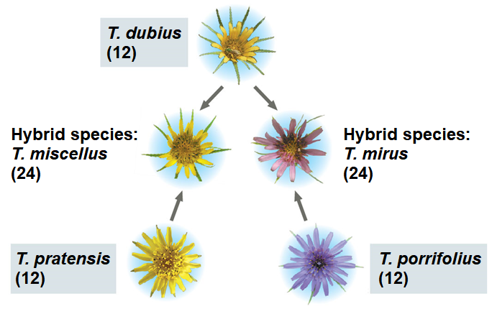
Slide 23
At least five new plant species have originated by polyploid speciation since 1850
  EX: in the genus Tragopogon (goatsbeard), 2 allopolyploid species have evolved from
Many important crops (
Plant geneticists can produce new polyploid species using
Notes:
Figure 24.11 Allopolyploid speciation in Tragopogon

Slide 24
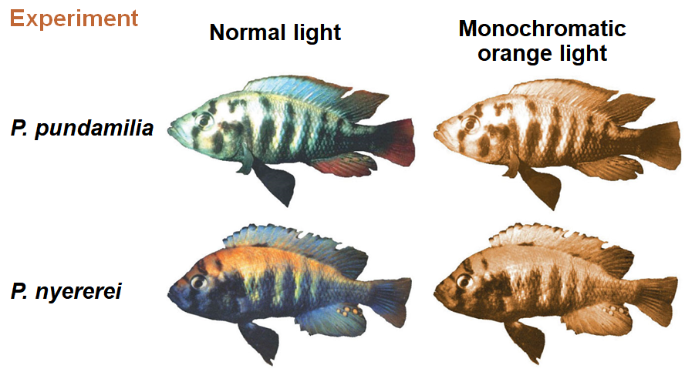
B. Sexual Selection
Sexual selection can
Sexual selection for mates of different colors has likely contributed to

Slide 25
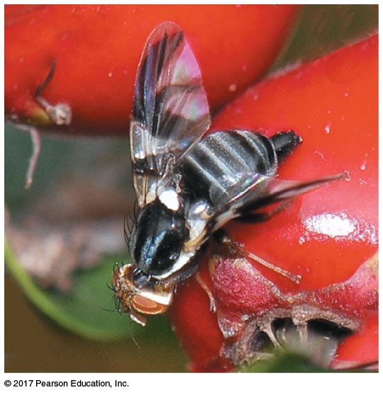
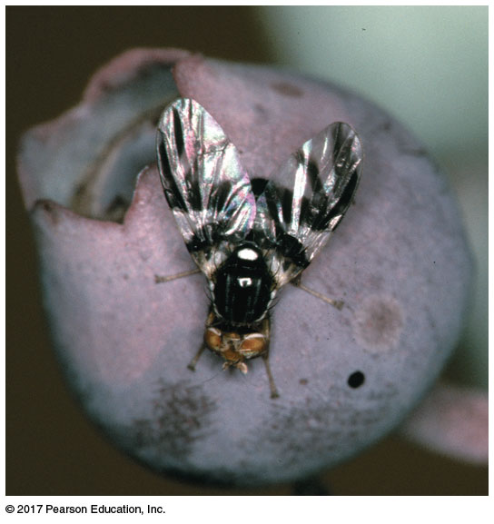
C. Habitat Differentiation
Sympatric speciation can also result from the appearance of
  EX: populations of the North American maggot fly (Rhagoletis pomonella) can live on native hawthorn trees, as well as
  Flies that use different host species experience

Slide 26
Allopatric & Sympatric Speciation: A Review
In allopatric speciation, geographic isolation restricts
Reproductive isolation may then arise as a by-product of genetic changes resulting from
Even if contact is restored between
In sympatric speciation, a reproductive barrier isolates a subset of a population without geographic separation from
Sympatric speciation can result from

Slide 27
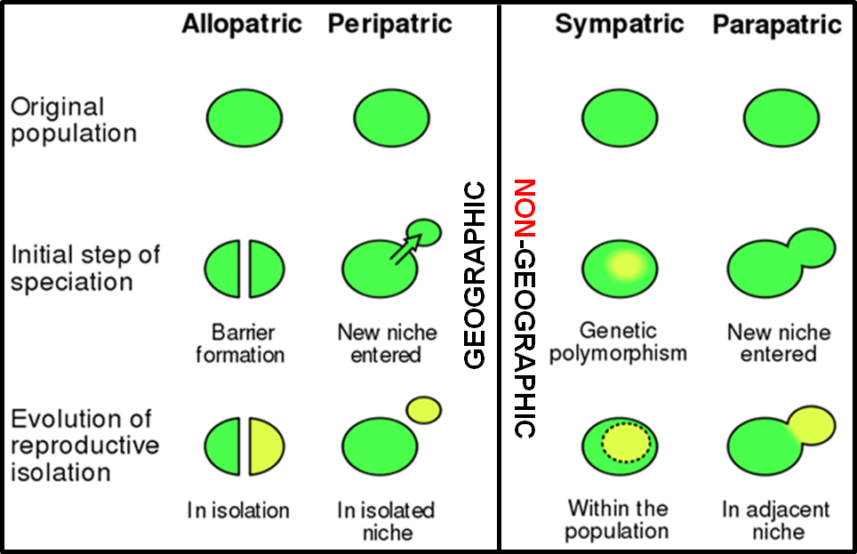
Visual comparison of speciation types

Slide 28
Concept 24.3: Hybrid zones reveal factors that cause reproductive isolation
A hybrid zone is a region in which members of different species
A hybrid zone can occur in a single band where
  EX: two species of toad in the genus Bombina interbreed in
Hybrids are the result of mating between species with
Hybrids often have
The distribution of hybrid zones can be more complex if parent

Slide 29
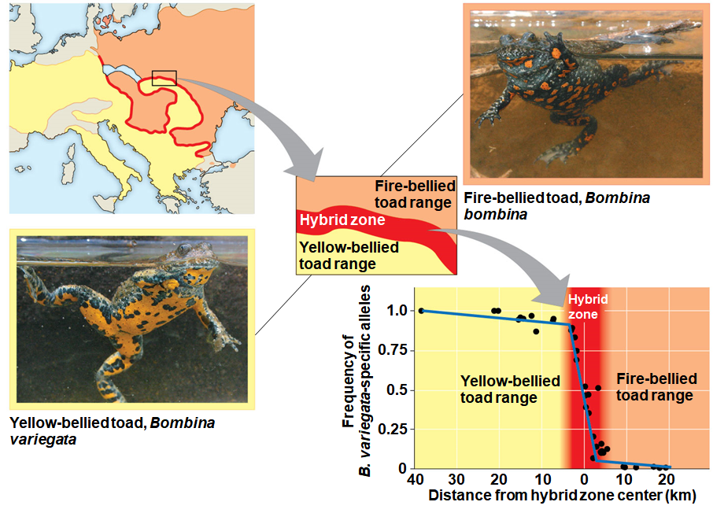
Figure 24.13
Notes:
Figure 24.13 A narrow hybrid zone for Bombina toads in Europe

Slide 30
Hybrid Zones and Environmental Change
Change in environmental conditions can result in the relocation of existing hybrid zones or the production of
  EX: the hybrid zone between black-capped and Carolina chickadees has shifted northward in response to
  EX: the species range of southern flying squirrels now overlaps with that of the
Breeding between hybrids and parent species can result in the transfer of alleles from
The transfer of novel alleles may help

Slide 31
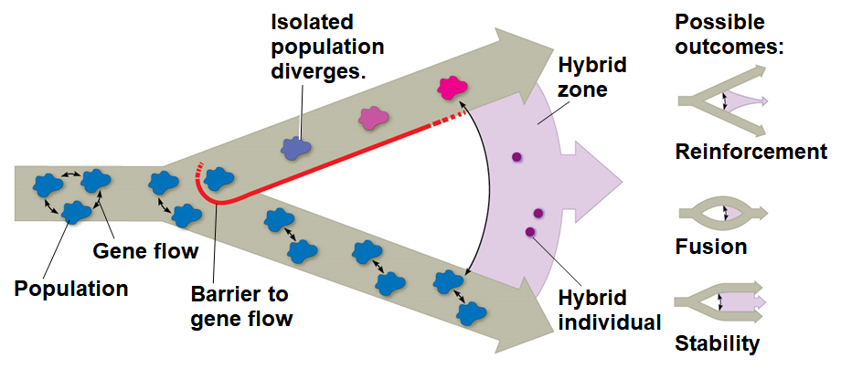
Hybrid Zones over Time
If hybrids do not become reproductively isolated from their parent species, then three alternate outcomes are possible:
Notes:
Figure 24.14_4 Formation of a hybrid zone and possible outcomes for hybrids over time (step 4)

Slide 32
1. Reinforcement: Strengthening Reproductive Barriers
When hybrids are less fit than parent species, reinforcement of reproductive barriers may occur through
Over time, the
Where reinforcement occurs, reproductive barriers should be
  EX: female flycatchers recognize and select mates of their own species when choosing between
  Female flycatchers frequently make mistakes when selecting males from the

Slide 33
2. Fusion: Weakening Reproductive Barriers
If hybrids are as fit as parents, there can be
If gene flow is great enough, reproductive barriers weaken, the
  EX: pollution in Lake Victoria has reduced the ability of female cichlids to distinguish males of

Slide 34
3. Stability: Continued Formation of Hybrid Individuals
Extensive gene flow from outside the hybrid zone can overwhelm selection for
  EX: parent species of Bombina routinely migrate into the narrow hybrid zone, resulting in

Slide 35
Concept 24.4: Speciation can occur rapidly or slowly and can result from changes in few or many genes
Question: How long for new species to form and how many
The rate of speciation can be studied using the fossil record,
The fossil record includes examples of species that appear suddenly, persist unchanged for some time, and
Punctuated equilibria describes these periods of apparent
The punctuated equilibrium model contrasts with a model of

Slide 36
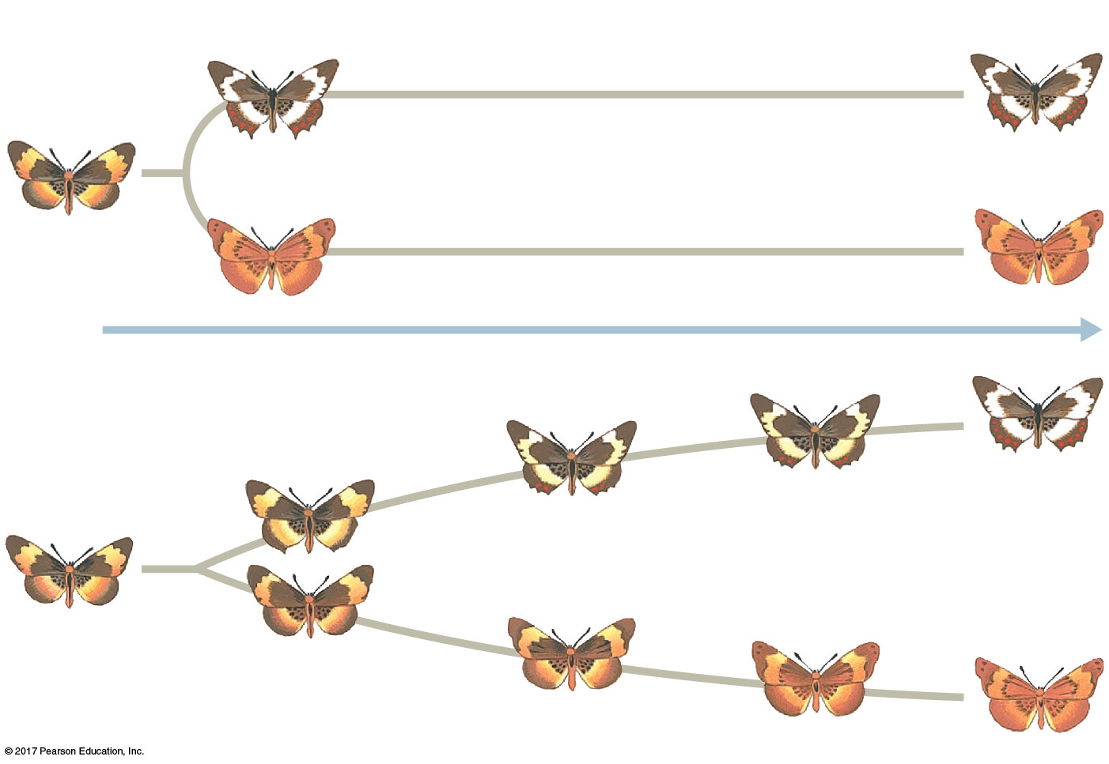
Figure 24.16
(a) Punctuated model
Time
(b) Gradual model
Notes:
Figure 24.16 Two models for the tempo of speciation

Slide 37
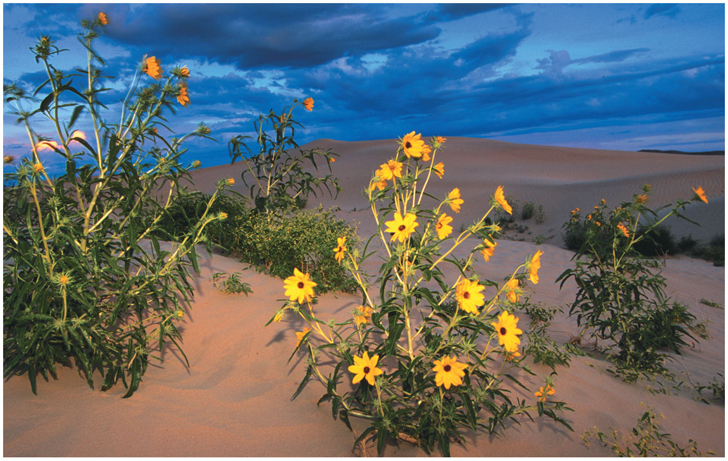
Speciation Rates
The punctuated pattern in the fossil record suggests that
  EX: Sunflower Helianthus anomalus was formed by hybridization between two other
  The interval between speciation events can range from 4,000 years (some cichlids) to 40 million years (some beetles), with
Notes:
Figure 24.17 A hybrid sunflower species and its dry sand dune habitat

Slide 38
Studying the Genetics of Speciation
A fundamental question of evolutionary biology persists:
Depending on the species in question, speciation might require
  EX: In Japanese Euhadra snails, the direction of shell spiral affects
  In monkey flowers (Mimulus), at least two loci affect flower color, which
  Pollination that is dominated by either hummingbirds or bees can lead to
  In other organisms, speciation can be influenced by

Slide 39
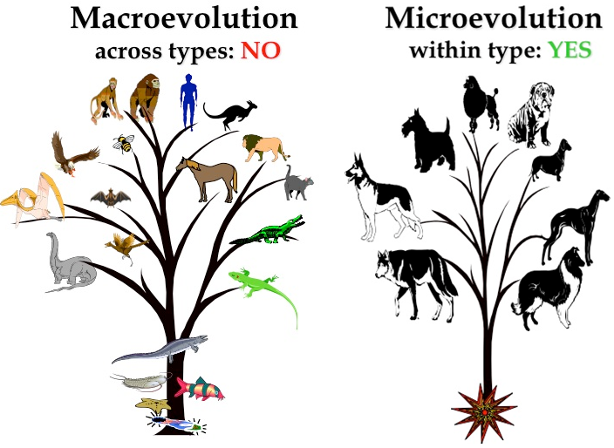
From Speciation to Macroevolution
Microevolution happens on a
Macroevolution happens on a
Evolution at both of these levels relies on the same, established

